Slide 1

Course Objectives
To recall the concepts of object oriented programming.
To motivate towards Object Oriented Approach of problem solving.
To introduce the implementation issues of Basic Object Oriented Concepts in a programming language like C++.
To enable the participants to write application programs using the object oriented features of C++.
To introduce advanced features of C++ like Templates, etc.

Slide 2
Topic Coverage:
Day1
  Introduction to Object Oriented Concepts
  Basics of C++
  Parameter Passing techniques
  Classes and Objects
  Access Specifiers
  Constructors and Destructors
Day 2
  Dynamic Memory Allocation
  Inline Functions
  Static Members
  Const Members
  Polymorphism
  ‘this’ pointer
  Aggregation
  Cin & Cout
Day 3
  Inheritance
  Dynamic Binding
  Abstract classes
Day 4
  Namespaces
  Exception Handling
  Templates and STL
Day 5 ( LC only)
  Project Execution
Day 6 (LC only)
  Project Execution and evaluation

Slide 3
Evaluation Components:
Test on Day 7
Project submission on Day6 (LC only)
Submission of Assignments is mandatory to take up the Module Test
Notes:
The evaluation components used in this module are
1 module test (on the last day of the course)
1 project (on the last day of the course) for LC only
While the coding for the project starts from Day 4 of the course, it is necessary to ensure proper testing and review of the code aptly.
Submission of assignments aptly is prerequisite for appearing for the test.

Slide 4
References
Brad J. Cox, Andrew J. Novobilski Object-Oriented Programming – An evolutionary approach, Addison-Wesley, 1991.
J. Rumbaugh, M. Blaha, W. Premerlani, F. Eddy, W. Lorensen. Object-oriented modeling and design. Prentice-Hall, Englewood Cliffs, N.J., 1991.
G. Booch. Object-oriented analysis and design with applications. Benjamin/Cummings, Redwood City, CA, 1994.
Robert Lafore, Object oriented programming in C++, Galgotia Publications.
Herbert Schieldt,The Complete Reference C++,Tata McGraw Hill Publications.
Bjarne Stroustrup, The C++ Programming Language, 3rd edition, Addison-Wesley.
Yashavant Kanetkar, Let us C++, BPB publications.

Slide 5
Session Plan - Day 1
Programming Techniques
Introduction to Object Oriented Concepts
Basics of C++
Reference Variables
Parameter Passing techniques
Abstract Data types
Classes and Objects
Access Specifiers
Class – Best Practices and Guidelines
Constructors and Destructors

Slide 6
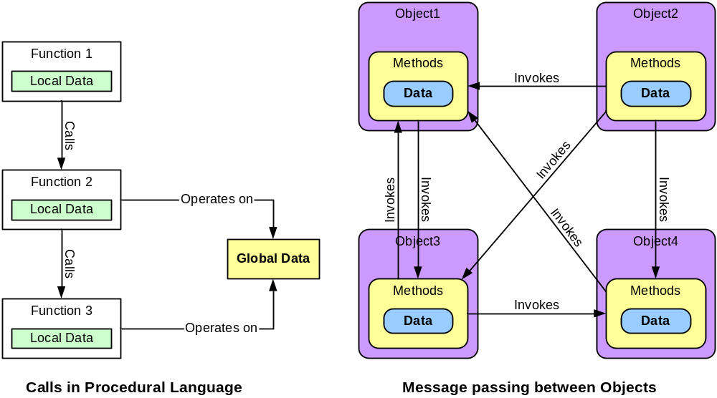
Procedural versus Object Oriented Programming
In procedural programming, functions operate based on either local or global data
In Object oriented programming, Objects exist and objects interact with other objects

Slide 7
Programming Techniques
Unstructured
  Sequence of instructions, which manipulated global data
  As size increases, code becomes more complex to maintain
Procedural Programming
  Brought in Modularity in coding, enhancing maintainability
  Common functionalities grouped into separate modules
  Complexity made manageable by hiding complexity inside functions Introduced the concept of structures (also known as data structures)
Object Oriented Programming
  Data structures combined with relevant functions to create reusable objects
  Focus of this course

Slide 8
Object Oriented Concepts
Abstraction: Process of forming of general and relevant information from a complex scenarios.
Encapsulation: Localization of information within an object. This also leads to Information Hiding
Inheritance: Is a process by which one object acquires the properties of another object
Polymorphism: allows the programmer to use “one interface” for “many functions”.
Notes:
As procedures are used to build structured program, objects are the building blocks of object oriented programs
A primary rule of object-oriented programming is - as the user of an object, you would never need to know what is there inside the object!
These characteristics represent a pure approach to object-oriented programming:
Every object contain some member variables and member methods which work upon the member variable.
A program is collection of objects, which needs to interact among them to do a process. The interaction of objects is also called as message passing.
Every object has a type as objects instantiated from a class, Here class is considered as a type.
Objects have state, behavior, and identity
Every object:
Contains data: The data stores information that describes the state of the object.
Has a set of defined behavior. This behavior consist of all the things that the object "knows" how to do. These are the methods present inside the object.
Has an individual identity. Each object is different from the other object even if they are instantiated from the same class.
Abstraction -> It denotes the essential characteristics of an object that distinguish it from all other kind of objects and thus provide crisply defined conceptual boundaries, relative to the perspective of the viewer. It focuses on observable behavior of an object.
Class -> It is a set of objects that share a common structure and a common behavior.
Data Member
Member Methods -> denotes the service that a class offers to its client.
Object -> Object is an instances of a class. Thus an object is an entity that has attributes and provide certain operations that are defined for the particular object.
Encapsulation -> Focuses upon the implementation that gives rise to the observable behavior.
Access Specifiers
Data Hiding
Inheritance -> Opens the possibility of extending and adapting object description and implementation without changing their source code.
Polymorphism
Static and Dynamic Polymorphism

Slide 9

Basics of C++
C++ is an Object Oriented programming language
It can be considered as a super set of C
This enables backward compatibility
Bjarne Stroustrup first invented “C with Classes” and then it was renamed to C++ in 1983.
C++
Advanced Features
Object Oriented Features
C Language
Notes:
C++ is an Object-Oriented Language developed by Bjarne Stroustrup in 1983 at AT&T Bell Labs.
Aims to combine the power and elegance of C Programming language and Object-Oriented features of Simula.
Has undergone enormous improvements over the years and has become one of the most popular programming languages.
Is an upgrade of C and hence preserves the earlier investment.
In 1997, ANSI/ISO standards committee standardized C++ and incorporated several new features to the
language specifications.
Today more than a million programmers use C++ to write software for machines ranging from PCs to
Supercomputers.
Is used extensively in systems programming scientific applications, data analysis, simulation and other mainstays of telecom research.
Like C, C++ is also case sensitive.

Slide 10
Basics of C++ Comments
C++ style comments are single line comments
C++ also supports C Style comments (backward compatibility with C)
C- Style Comments:
/* C- Style Single Line Comment*/
/********************************************************
* This is C Style Multiple Line Comment
* Used for Function Headers
********************************************************/
C++ Style Comments:
// This is a single line comment
Notes:
/* */ called a multiline comment, is the only comment supported by C
// also called single line comment is supported by C++
Compilers ignore the comments
Compilers do not provide any machine language object code for the comments
Comments help other programmers to understand your program.
Here are a few guidelines for comments:
- Comments should make the code accessible to the reader
- Explain the code's intent in the heading
- Keep the comments up to date (if you update the code, update the comment)
- Don't comment bad code--fix it
-

Slide 11
Data types of C++
Data Types
User defined types
Derived types
structure
array
union
Built-in types
pointer
class
reference
enumeration
integer type
void
floating type
int
char
float
double

Slide 12
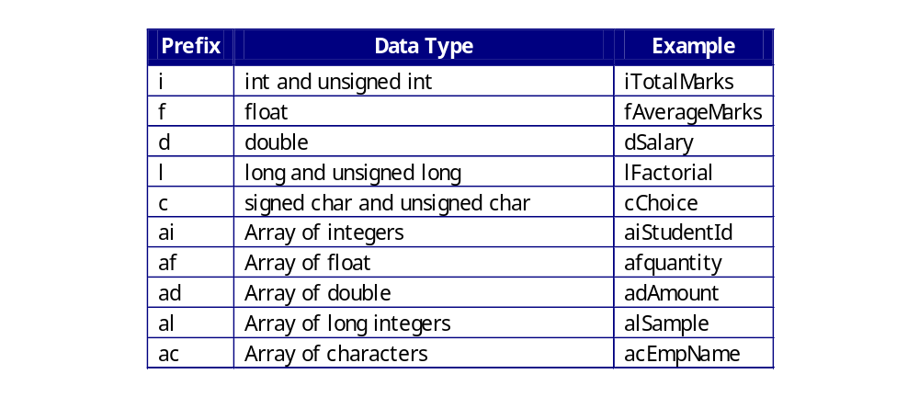
Variables and naming convention
Variables can be declared anywhere in the program, just before it is used
The naming convention followed for the variables need to be consistent and meaningful
Hungarian Notation must be followed similar to C for variable naming conventions
All primitive C Data types are supported in C++ due to backward compatibility
Notes:
The name of the variable has nothing to do with its data type.
In C++, when a variable is declared, it is not assigned any value explicitly. It will have a value whatever bits happened to be in its area of memory when declared.
Identifier:
The name of an item in a program, it could be the name of function, variables, arrays etc…
The name of a program element is called an identifier.
Guidelines for using data:
Declare all variables: Some languages may not require variable declaration but still declare the variables so that you are using the data more carefully.
Use naming conventions
Note:
Improper data initializations cause lot of errors in programming.
In C++, variables once declared will contain garbage values. To overcome the problems of variables containing values that you do not expect, initialize the variables.

Slide 13
Control Structures
Control Structures are statements which changes the execution sequence of the program
C++ supports all the control structures supported in C
  If, else if, else
  switch case
  for loop
  while loop
  do while
Notes:
Control statements specify the order of the execution of the statements in the program.
Control statements are of 2 types: Selectional and Iterational (Iterational constructs are discussed later)
Selectional statements are of 2 types: unconditional control statements and conditional control statement
(1) unconditional control statement:
goto statement: This statement is used to transfer the control to another part of the program without
checking for any conditions.
This is an unstructured way of programming and is recommended not to use.
Program written using goto is difficult to indent. Indentation shows the logical structure of the program and
using goto in programs makes the indentation impossible.
Also, goto statements defeats compiler optimizations. Some optimizations depend on a program's flow of
control. An unconditional goto makes the flow harder to analyze and reduces the ability of compiler optimizations.
(2) conditional control statements:
if..else statement: This statement is used to test a condition and then take one of the two possible actions.
Syntax:
if (condition) {
statement/s to be executed when condition evaluates to true;
}
else {
statement/s to be executed when condition evaluates to false;
}
If a condition is true, then the statement/s below the if are executed and when the condition evaluates to false, the statement/s below the else are executed.
The if..else statements can also be nested.

Slide 14
Operators Common in C and C++
Arithmetic operators +, -, *, /, %
Pre and Post Unary Operators ++, --
Assignment operator =
Compound Assignment Operators =, +=, -=, /=, *=, %=
Relational Operators >, >=, <, <=, == , !=
Logical Operators !, &&, ||
Address Operator &
sizeof operator
Bitwise logical operators ( & - AND, | - OR, ! - XOR, ~ - NOT)
Bitwise Shift operators ( << - Left Shift , >> - Right Shift )
Conditional operator ( ? : ) also called as Ternary Operator
  Syntax:
      <var-name> = (<condition>) ? value-if-true : value-if-false ;
      iMax=(iNum1>iNum2) ? iNum1 : iNum2 ;
Notes:
The basic arithmetic operators help us in performing the arithmetic operations.The % (modulo operator) is used to find the reminder of a divide operation
eg.int x=5,y=2;
int z=5/2; will store 2 in z
int z=5%2 will store 1 in z
% operator cannot be applied to float data type. Hence the instruction 5.2 % 2.5 will result in error
For comparing if 2 values are equal or not remember to use == and not a single =. == indicates comparisons and = indicates assignment operation
eg. int x=5,y=3
x==y will be considered as an conditional expression that will be evaluated to true(non-zero) for false(zero)
x=y will be considered as an assignment expression which will assign 3 (value of y) to x. x after the instruction will have value 3.

Slide 15
Operators in C++
Scope Resolution Operator ( ::)
Memory Allocation/De-allocation operator (new and delete)
Member Access operators ( -> , .* , ->* , . )
Reference Operator ( & )
Insertion and Extraction Operators ( << and >> ).
Notes:
Logical operators available are ! (NOT), && (AND), || (OR)
eg. consider 3 variables x,y,x containing values 1,2,3 respectively
x=1, y=2, z=3
the condition x==1 && y == 3 will evaluate to false
the condition x==1 && z==3 will evaluate to true
the condition x==1 || y==3 will evaluate to true
the condition x==1 || z==3 will evaluate to true
the condition !(x <2 && y==2) will evaluate to false
AND table followed for evaluation is : T && T~T, T && F~F, F && T~F, F && F~T
OR table followed for evaluation is : T || T~T, T || F~T, F || T~T, F || F~F
NOT table followed is : ! T~F,! F~T
Classification of Operators:
Based on the number of operands:
Unary operators ++, --
Binary operators +,-,*,/,%,==,<,>,>=,<=,!=,&&,||
Ternary operators ? :
(2) Based on the operations performed:
Arithmetic operators
Relational operators
Logical operators

Slide 16
Scope Resolution Operator (::)
Used for resolving the scope of the variables
Used for defining methods outside the class declaration
# include <stdio.h>
int iNum=10;
int main(int argc,char** argv) {
int iNum=20;
if(20==iNum) {
int iNum=30;
printf("%d %d",iNum,::iNum);
}
printf("\n%d %d",iNum,::iNum);
return 0;
}
30 10
20 10

Slide 17
Reference Variables
Reference variable is an alias created for an already existing variable.
Change in reference will change the value of the variable and vice versa
Should be initialized when declared and cannot be reinitialized
A variable can have multiple reference
Array of reference is not allowed
int main(int argc,char** argv) {
int iNum=10;
/* Declare and initialize reference variable */
int& riNum = iNum;
printf("%d %d",iNum,riNum);
/* Change the value through reference variable */
riNum=20;
printf("\n%d %d",iNum,riNum);
return 0;
}
10 10
20 20
Notes:
Note that unlike the pointer variable where the pointers can be made to point to different locations, reference variables point to only one location as determined during initialization.
These could be thought of as equivalent to constant pointers.

Slide 18
Parameter Passing Techniques - Example
void SwapByAdd(int* piVal1,int* piVal2) {
int iTemp;
iTemp=*piVal1;
*piVal1=*piVal2;
*piVal2=iTemp;
}
void SwapByValue(int iVal1,int iVal2){
int iTemp;
iTemp=iVal1;
iVal1=iVal2;
iVal2=iTemp;
}
int main(int argc,char** argv) {
int iNum1=10,iNum2=20;
SwapByValue(iNum1,iNum2);
printf(“%d %d”,iNum1,iNum2);
SwapByAdd(&iNum1,&iNum2);
printf("%d %d",iNum1,iNum2);
SwapByRef(iNum1,iNum2);
printf("\n%d %d",iNum1,iNum2);
return 0;
}
void SwapByRef(int& riVal1,int& riVal2){
int iTemp;
iTemp=riVal1;
riVal1=riVal2;
riVal2=iTemp;
}
10 20
20 10
10 20

Slide 19
Functions - Pass By Pointer Versus Pass by Reference
Referencing Offers a clean, elegant and efficient way to pass parameters to functions that changes the value of actual parameter
Difficulty in de-referencing is eliminated in pass by reference
Calling syntax is much simpler compared to call by address
Pass by Reference needs no memory

Slide 20
Abstract Data Types (ADTs)
Abstraction of data structures results in ADTs
They are partial solution to modeling a problem.
An ADT is a model of a data structure that is characterized by the following properties.
    It has a type.
    It has a set of operations. This set is called an interface. In object oriented terms the set of operations define the behavior of the object
    Operations of the interface are the only access mechanism to the type's data structure
    Specifies what each operation does, but doesn’t reveal how any given operation works
The closest to abstract data type in C is structures
In C++ it is implemented using ‘Classes’

Slide 21
Structures in C
Composite data type
Contains one or more logically related data (similar or dissimilar) grouped together under a single name for convenient handling
Variables declared inside structure are called fields or members
Functions cannot be part of Structure
Structure variables can be created using structure name.
Members can be accessed using <Structure variable Name>.<Member Name>
struct _employee {
int iEmpId;
float fBasic;
float fTotSal
};
/* Structure variable creation */
struct _employee E1;
/* Accessing members */
E1.iEmpId=43002
E1.fBasic=2500.00
E1.fTotSal=E1.fBasic+300;

Slide 22
Structures in C++
C++ extends the features of C Structures
C++ structures can have functions as its members.
Default access specifier for Structure members is “public”. Access specifiers will be dealt in later slides.
struct _employee {
int m_iEmpId;
float m_fBasic;
float m_fSal;
void CalculateSal() {
/* Code for sal calculation */
}
}
struct <structure_name> {
private:
/* private data member and methods */
protected:
/* protected data member and methods */
public:
/* public data member and methods */
};

Slide 23
Class
Basic unit of abstraction in C++
Extension of the concept of structures
Provides a technique to bind data and functions together (Encapsulation)
Data Members – Variables declared inside the class
Member Functions – Functions declared/defined inside the class
Member Functions are also called as Methods
class Employee {
int m_iEmpId;
float m_fBasic;
public:
void CalculateSal() {
/* Code for sal calculation */
}
}
class <class_name> {
private:
/* private data member and methods */
protected:
/* protected data member and methods */
public:
/* public data member and methods */
};
Notes:
Every object contains some member variables (Data) and member methods (operations on the data).
Methods work upon the member variable.
A program is collection of objects, which needs to interact among them to do a process. The interaction of objects is also called as message passing.
Objects have state, behavior, and identity
Every object:
Has an individual identity. Each object is different from the other object even if they are instantiated from the same class.
Contains data: The data stores information that describes the state of the object.
Has a set of defined behavior. This behavior consist of all the things that the object "knows" how to do. These are the methods present inside the object.

Slide 24
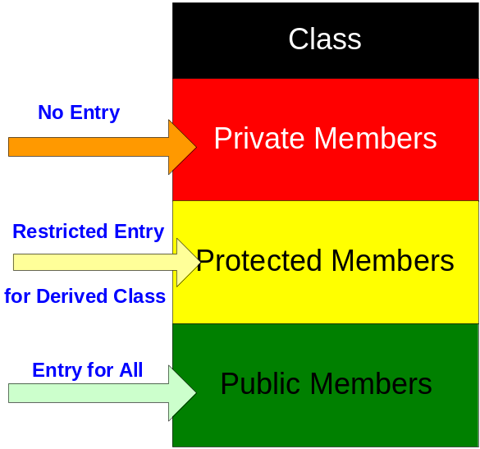

Class – Implementation of Encapsulation (Access Specifiers)
Public Members
  Accessed within and outside the class
Protected Members
  Accessed within and only by derived classes
Private Members
  Accessed only within the class
Good design practice is to keep data members under private and methods under public
Methods invoked ONLY by other methods of the same class are kept private
Such methods are called helper methods
X

Slide 25
Objects
Instance of a class in memory
Unique, identifiable, self – contained entity that contains attributes and behaviors
If class is viewed as a data type then object can be considered as a variable of class data type.
Ex: ‘Arun’ is an Object of Trainee Class
Syntax for creating objects
<Class_Name> Object1, Object2,…..;
Ex: Trainee oT1, oT2;
Syntax for Invoking Methods
        Object1.Method1();
        Object1.Method2();
Ex: oT1.TakeTest();
oT2.GetResults();

Slide 26
Class and Objects – Example
class Trainee {
private:
int m_iEmpId;
char m_acEmpName[25];
float m_fBasic;
float m_fHRA;
public:
void SetData(int iEmpId,
char acEmpName[],float Basic,
float fHRA) {
………. }
void CalculateSal() {
………. }
void CalculateTax() {
…………}
}; //class Trainee ends here
int main(int argc,char** argv) {
/* Object Creation */
Trainee oT1;
/* Invoking SetData */
oT1.SetData(101,”Henry”,1200,150)
/* Invoking CalculateSal */
oT1.CalculateSal();
/* Invoking CalculateTax */
oT1.CalculateTax();
}
Notes:
Rule:
The data members never need to be made public. They can be either private or protected.
Protected members are used for making the data members of base (parent) class accessible in the derived (child) class.
The member functions called as methods will be usually as public.
In case of helper functions methods could be made private. Helper functions are those which will be used by the other methods.
If at all the data members are made public (under unavoidable circumstances), then they need to be declared as const.

Slide 27
Class Access Specifiers – Example
class Trainee {
int m_iEmpId;
char m_acEmpName[30];
float m_fBasic;
float m_fHRA;
public:
void SetData(int iEmpId,
char acEmpName[],float fBasic,
float fHRA) {
……….
}
void CalculateSal() {
……….
}
void CalculateTax() {
…………
}
};
int main(int argc,char** argv) {
/* Object Creation */
Trainee oT1;
/* Invalid – Accessing private
members outside the class */
oT1.m_iEmpId=43003;
oT1.m_fBasic = 1200.00
oT1.m_fHRA=350.00
/* Valid – Accessing public members
outside the class */
oT1.SetData(101,”Dave”,1200,350)
oT1.CalculateSal();
oT1.CalculateTax();
}

Slide 28
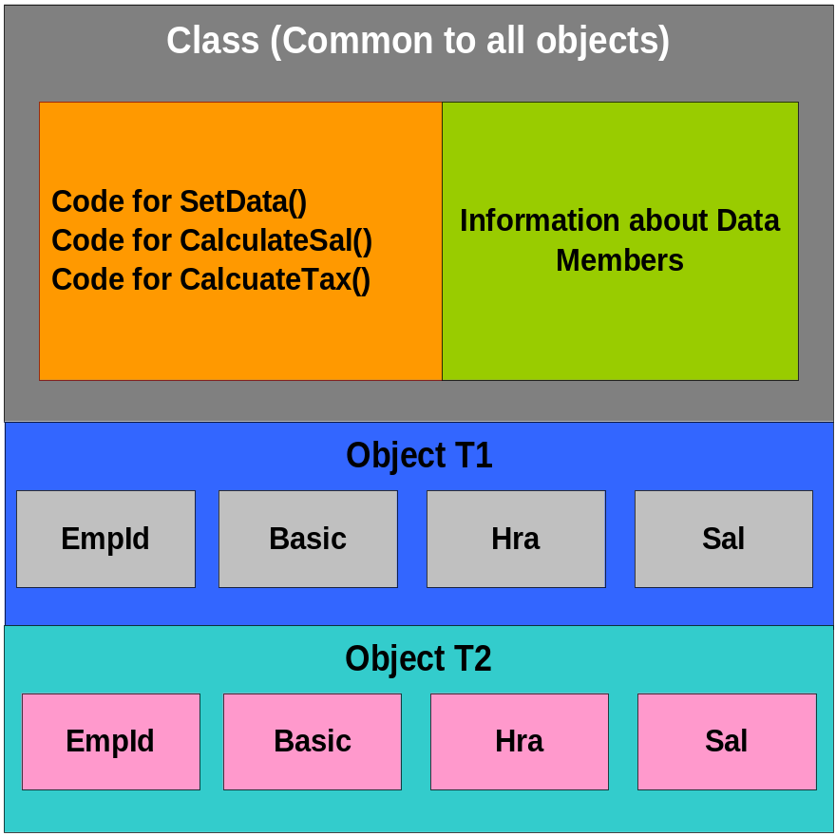
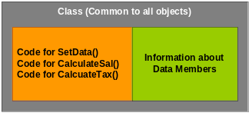
Memory allocation for Classes and Objects
class Trainee {
private:
int m_iEmpId;
float m_fBasic;
float m_fHRA;
float m_fSalary;
public:
void SetData(int iEmpId, float fBasic,
float fHRA){
}
void CalculateSal() {
// code goes here
}
void CalculateTax() {
//code goes here
}
};
Trainee oT1,oT2;

Slide 29
Class – Defining methods outside the class
/* Class Declaration */
class Trainee {
private:
int m_iEmpId;
char m_acEmpName[25];
float m_fBasic;
float m_fHRA;
public:
void SetData(int iEmpId,
char cEmpName[],
float fBasic,float fHRA) ;
void CalculateSal() ;
void CalculateTax();
};
/* Method Definitions */
void Trainee::SetData(iEmpID,acEmpName,
fBasic,fHra){
… …../* Code to set the data */
}
void Trainee::CalculateSal() {
……… /* Code to calculate salary */
}
void Trainee::CalculateTax() {
……… /* Code to calculate Tax */
}
/* Object Creation */
Trainee oT1;
oT1.SetData(43003,”Dave”,1200,350);

Slide 30
Class – Coding Standards, Best Practices & Guidelines
One class per file
Declare the class in ‘<class_name>.h’ header file using below format to avoid multiple inclusion of class declarations
  #ifndef _CLASSNAME_H
  #define _CLASSNAME_H
  //Class declaration
  #endif
Define all the methods in ‘<class_name>.cpp’ file after including header file
Provide Class Header (Refer Structure Header C-Programming/PF)
Use File Header and Footer (Refer C-Programming/PF)
Provide Function/Method Header Block (Refer C-Programming/ PF)

Slide 31


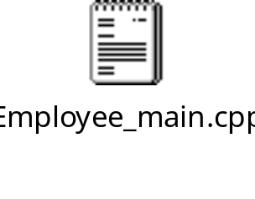
Class – Coding Standards, Best Practices and Guidelines
Coding Standards
  Member variables - m_<Variable Name>
    m_iEmpId, m_fBasic, m_acName
  Methods – Hungarian Notation
    SetEmployeeNumber(), CalculateSalary(), CalculateTax()
  Object – o<Object_Name>
    oTrainee1,oTrainee2

Slide 32
Constructors
Used for automatic initialization of instance variables during Object creation.
Has the same name of the class and do not have return types (not even void)
Invoked automatically when an object of its associated class is created
/* Class Declaration */
class Trainee {
private:
int m_iEmpId;
char *m_pcName;
public:
/* Declaration of Constructor */
Trainee();
/* Declaration of other methods */
void CalculateSal() ;
void CalculateTax();
};
/* Constructor Definition */
Trainee::Trainee() {
/* Initial Values */
m_iEmpid=-1;
m_pcName=NULL;
}
/* Definition of other methods */
void Trainee::CalculateSal() {
……… /* Code to calculate salary */
}
void Trainee::CalculateTax() {
……… /* Code to calculate Tax */
}

Slide 33
Constructors – Types
Default Constructor
  Takes no parameters and no return value (NOT even void)
  Automatically written by C++ if no user-defined constructor is present
  The programmer can redefine the default constructor.
Parameterized Constructor
  Takes one or more parameters
  These arguments can be used for initializing the objects when created
Copy Constructor
  Takes only one argument which is of same class type
  Generally used to copy some selective data members of one object to another
  Automatically written by the compiler if no user defined copy constructor is present.
  default copy constructor takes exact copy of one object to another

Slide 34
Constructors – Example
/* Class Declaration */
class Trainee {
private:
int m_iEmpId;
char *m_pcName;
public:
Trainee();
Trainee(int Id, char Name[25]);
Trainee(Trainee& RefTrainee);
void CalculateSal() ;
};
/* Default Constructor */
Trainee::Trainee() {
m_iEmpId=0;
m_pcName=NULL;
}
/* Parameterized Constructor */
Trainee::Trainee(int Id, char Name[25]){
m_pcName=malloc(strlen(Name)+1);
strcpy(m_pcName,Name);
m_iEmpId=Id;
}
/* Copy Constructor */
Trainee::Trainee(Trainee& rt) {
int len=strlen(rt.m_pcName)+1;
m_pcName=malloc(len+1);
strcpy(m_pcName,rt.m_pcName);
m_iEmpId=rt.m_iEmpId;
}
Trainee oT1;
Trainee oT2(43003,”David John”);
Trainee oT3=oT1;

Slide 35
Constructors – More about Copy Constructors
A copy constructor is one which takes only one argument of the same class type.
Here rt is a reference object.
/* Copy Constructor */
Trainee::Trainee(Trainee & rt) {
int len=strlen(rt.m_pcName)+1;
m_pcName=malloc(len+1);
strcpy(m_pcName,rt.m_pcName);
m_iEmpId=rt.m_iEmpId;
}
Generally, the copy constructor is used when you want to copy a part of data members of one object to a new object.
Trainee oT1, oT2;
oT2 = oT1; // takes exact copy
// or bit-by-bit copy
The copy constructor is called in 4 different situations:
  Trainee oT1(oT2); // Copy constructor is called
  Trainee oT3 = oT2; // Copy constructor is called
  oT3 = oT2; // Here a bit by bit copy operation takes place
  void Display(oT1, oT2); // When the object is passed as parameter. And
  oT2 = Compare(oT3, oT4); // When the object is returned to calling point.

Slide 36
Destructor
is a method which automatically gets invoked when an object is destroyed
has the same name as the class and preceded by a tilde(~)
takes no arguments & No return value. So, a class can have only one destructor.
used for housekeeping jobs like releasing memory, resources…etc
/* Class Declaration */
class Trainee {
private:
int m_iEmpId;
char *m_pcName;
public:
Trainee();
Trainee (int Id, char Name[25]);
~Trainee();
};
Trainee::Trainee(int Id,char Name[]) {
m_pcName=malloc(strlen(Name)+1);
………/ * Code */
}
Trainee::~Trainee() {
if(m_pcName!=Null) {
free(m_pcName);
}
}
Notes:
The destructors are called when the objects’ life ends (destroyed). Since in the above example the objects are created in the main functions, the life time of the objects is the end of main function.
Hence when the main function terminates, the destructors are called.
Also note the way in which the de-allocation of the memory happens in the destructors.
The memory can be freed only if it has been allocated in the first place. In case an object was just created without any parameters then the memory would not have been allocated. To handle such cases the deallocation of memory in the constructors need to happen conditionally.

Slide 37
Summary
Programming Techniques
Introduction to Object Oriented Concepts
Basics of C++
Reference Variables
Parameter Passing techniques
Abstract Data types
Classes and Objects
Access Specifiers
Class – Best Practices and Guidelines
Constructors and Destructors

Slide 38

Thank You!

